Slide 1
INDEX
두 개 이상의 테이블에서 조회
계층형 쿼리(셀프 조인 고급)

Slide 2
두 개 이상의 테이블 조회
조인(JOIN)의 개념
조인(JOIN)의 구현
내부 조인
크로스 조인
외부 조인
셀프 조인

Slide 3
1. 조인(JOIN)의 개념
조인(JOIN) 이란?
여러 개의 테이블에서 원하는 자료를 조회
=> 정규화로 나누어진 테이블, 칼럼을 다시 모으는 것
사원번호, 사원명, 부서코드, 부서명, 관리자사원번호
를 조회 하려면? => 사원테이블, 부서테이블을 이용
조인(JOIN) 개념
조인 연산 = 카티션 곱 + 선택 연산의 형태
SELECT EMPLOYEE_ID, FIRST_NAME, A.DEPARTMENT_ID,
B.DEPARTMENT_ID, DEPARTMENT_NAME, B.MANAGER_ID
FROM EMPLOYEES A, DEPARTMENTS B /*카티션곱*/
WHERE A.DEPARTMENT_ID=B.DEPARTMENT_ID; /*선택연산*/

Slide 4
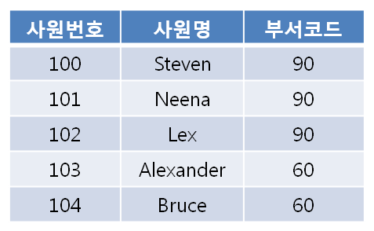
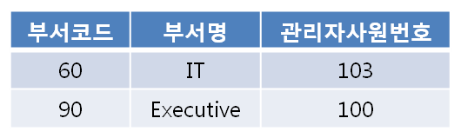
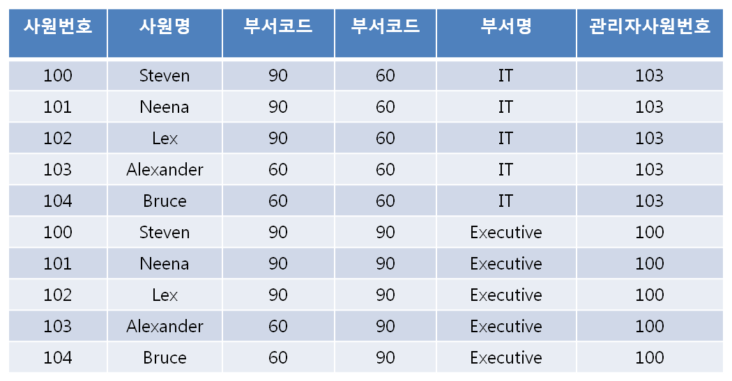
<사원 테이블>
<부서 테이블>
카티션 곱
선택연산

Slide 5
2. 조인(JOIN)의 구현
ANSI SQL 문법
FROM 절에 데이블 마다 조인관계를 JOIN과 ON 으로 표현
SELECT EMPLOYEE_ID, FIRST_NAME, A.DEPARTMENT_ID,
B.DEPARTMENT_ID, DEPARTMENT_NAME, B.MANAGER_ID
FROM EMPLOYEES A JOIN DEPARTMENTS B
ON A.DEPARTMENT_ID=B.DEPARTMENT_ID;
오라클 SQL 문법
FROM 절에 조인에 관련된 테이블 나열
WHERE 절에 조인관계 선언
SELECT EMPLOYEE_ID, FIRST_NAME, A.DEPARTMENT_ID,
B.DEPARTMENT_ID, DEPARTMENT_NAME, B.MANAGER_ID
FROM EMPLOYEES A, DEPARTMENTS B
WHERE A.DEPARTMENT_ID=B.DEPARTMENT_ID;

Slide 6
3. 내부(INNER) 조인(1/2)
오라클 SQL 문법 (2개 테이블)
SELECT EMPLOYEE_ID, FIRST_NAME, A.DEPARTMENT_ID,
B.DEPARTMENT_ID, DEPARTMENT_NAME,
B.MANAGER_ID
FROM EMPLOYEES A, DEPARTMENTS B
WHERE A.DEPARTMENT_ID=B.DEPARTMENT_ID;
ANSI SQL 문법 (2개 테이블)
SELECT EMPLOYEE_ID, FIRST_NAME, A.DEPARTMENT_ID,
B.DEPARTMENT_ID, DEPARTMENT_NAME,
B.MANAGER_ID
FROM EMPLOYEES A [INNER] JOIN DEPARTMENTS B
ON A.DEPARTMENT_ID=B.DEPARTMENT_ID;

Slide 7
3. 내부(INNER) 조인(2/2)
오라클 SQL 문법 (3개 테이블)
SELECT EMPLOYEE_ID, FIRST_NAME, A.DEPARTMENT_ID,
A.JOB_ID, B.DEPARTMENT_ID, DEPARTMENT_NAME,
B.MANAGER_ID, C.JOB_ID, C.JOB_TITLE
FROM EMPLOYEES A, DEPARTMENTS B, JOBS C
WHERE A.DEPARTMENT_ID=B.DEPARTMENT_ID
AND A.JOB_ID = C.JOB_ID;
ANSI SQL 문법 (3개 테이블)
SELECT EMPLOYEE_ID, FIRST_NAME, A.DEPARTMENT_ID,
A.JOB_ID, B.DEPARTMENT_ID, DEPARTMENT_NAME,
B.MANAGER_ID, C.JOB_ID, C.JOB_TITLE
FROM EMPLOYEES A JOIN DEPARTMENTS B
ON A.DEPARTMENT_ID=B.DEPARTMENT_ID
JOIN JOBS C ON A.JOB_ID = C.JOB_ID;

Slide 8
4. 크로스(CROSS) 조인
ANSI SQL 문법
SELECT EMPLOYEE_ID, FIRST_NAME, A.DEPARTMENT_ID,
B.DEPARTMENT_ID, DEPARTMENT_NAME,
B.MANAGER_ID
FROM EMPLOYEES A CROSS JOIN DEPARTMENTS B;
오라클 SQL 문법
SELECT EMPLOYEE_ID, FIRST_NAME, A.DEPARTMENT_ID,
B.DEPARTMENT_ID, DEPARTMENT_NAME,
B.MANAGER_ID
FROM EMPLOYEES A, DEPARTMENTS B;

Slide 9
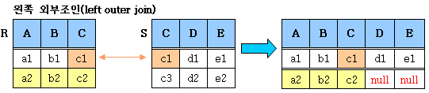
5. 외부(OUTER) 조인(1/3)
ANSI SQL 문법
SELECT EMPLOYEE_ID, FIRST_NAME, DEPARTMENT_NAME
FROM EMPLOYEES A
LEFT [OUTER] JOIN DEPARTMENTS B
ON A.DEPARTMENT_ID = B.DEPARTMENT_ID;
오라클 SQL 문법
SELECT EMPLOYEE_ID, FIRST_NAME, DEPARTMENT_NAME
FROM EMPLOYEES A, DEPARTMENTS B
WHERE A.DEPARTMENT_ID = B.DEPARTMENT_ID (+);

Slide 10
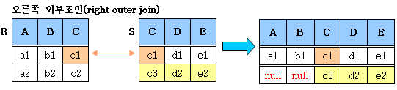
5. 외부(OUTER) 조인(2/3)
ANSI SQL 문법
SELECT EMPLOYEE_ID, FIRST_NAME, DEPARTMENT_NAME
FROM EMPLOYEES A
RIGHT [OUTER] JOIN DEPARTMENTS B
ON A.DEPARTMENT_ID = B.DEPARTMENT_ID;
오라클 SQL 문법
SELECT EMPLOYEE_ID, FIRST_NAME, DEPARTMENT_NAME
FROM EMPLOYEES A, DEPARTMENTS B
WHERE A.DEPARTMENT_ID (+) = B.DEPARTMENT_ID;

Slide 11
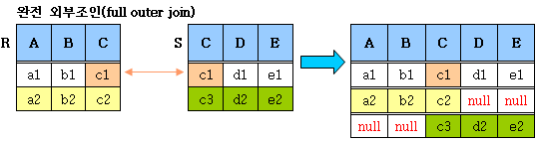
5. 외부(OUTER) 조인(3/3)
ANSI SQL 문법
SELECT EMPLOYEE_ID, FIRST_NAME, DEPARTMENT_NAME
FROM EMPLOYEES A
FULL [OUTER] JOIN DEPARTMENTS B
ON A.DEPARTMENT_ID = B.DEPARTMENT_ID;
오라클 SQL 문법
표현방법 없음
LEFT OUTER JOIN과 RIGHT OUTER JOIN 결합으로 표현

Slide 12
--일반 조인
--106건
SELECT COUNT(*)
FROM EMPLOYEES A JOIN DEPARTMENTS B
ON A.DEPARTMENT_ID = B.DEPARTMENT_ID;

Slide 13
--LEFT OUTER JOIN
--107건
SELECT COUNT(*)
FROM EMPLOYEES A
LEFT JOIN DEPARTMENTS B
ON A.DEPARTMENT_ID = B.DEPARTMENT_ID;

Slide 14
--대상건
SELECT EMPLOYEE_ID, FIRST_NAME, A.DEPARTMENT_ID, // ANSI
B.DEPARTMENT_ID, DEPARTMENT_NAME
FROM EMPLOYEES A
LEFT OUTER JOIN DEPARTMENTS B
ON A.DEPARTMENT_ID = B.DEPARTMENT_ID
ORDER BY DEPARTMENT_NAME NULLS FIRST;
SELECT EMPLOYEE_ID, FIRST_NAME, A.DEPARTMENT_ID, // Oracle
B.DEPARTMENT_ID, DEPARTMENT_NAME
FROM EMPLOYEES A,
DEPARTMENTS B
WHERE A.DEPARTMENT_ID = B.DEPARTMENT_ID (+)
ORDER BY DEPARTMENT_NAME NULLS FIRST;

Slide 15
--RIGHT OUTER JOIN
--122건
SELECT COUNT(*)
FROM EMPLOYEES A
RIGHT OUTER JOIN DEPARTMENTS B
ON A.DEPARTMENT_ID = B.DEPARTMENT_ID;

Slide 16
--대상건
SELECT EMPLOYEE_ID, FIRST_NAME, A.DEPARTMENT_ID,
B.DEPARTMENT_ID, DEPARTMENT_NAME
FROM EMPLOYEES A
RIGHT OUTER JOIN DEPARTMENTS B
ON A.DEPARTMENT_ID = B.DEPARTMENT_ID
ORDER BY EMPLOYEE_ID NULLS FIRST;
SELECT EMPLOYEE_ID, FIRST_NAME, A.DEPARTMENT_ID,
B.DEPARTMENT_ID, DEPARTMENT_NAME
FROM EMPLOYEES A,
DEPARTMENTS B
WHERE A.DEPARTMENT_ID (+) = B.DEPARTMENT_ID
ORDER BY EMPLOYEE_ID NULLS FIRST;

Slide 17
--FULL OUTER JOIN
--123건
SELECT COUNT(*)
FROM EMPLOYEES A
FULL OUTER JOIN DEPARTMENTS B
ON A.DEPARTMENT_ID = B.DEPARTMENT_ID;
--대상건
SELECT EMPLOYEE_ID, FIRST_NAME, A.DEPARTMENT_ID, B.DEPARTMENT_ID, DEPARTMENT_NAME
FROM EMPLOYEES A
FULL OUTER JOIN DEPARTMENTS B
ON A.DEPARTMENT_ID = B.DEPARTMENT_ID
ORDER BY DEPARTMENT_NAME NULLS FIRST,
EMPLOYEE_ID NULLS FIRST;

Slide 18
--오류
SELECT EMPLOYEE_ID, FIRST_NAME, A.DEPARTMENT_ID, B.DEPARTMENT_ID, DEPARTMENT_NAME
FROM EMPLOYEES A, DEPARTMENTS B
WHERE A.DEPARTMENT_ID (+) = B.DEPARTMENT_ID (+);
--두 조인을 하고 싶은 경우.. 다음 페이지

Slide 19
SELECT EMPLOYEE_ID, FIRST_NAME,
A.DEPARTMENT_ID, B.DEPARTMENT_ID,
DEPARTMENT_NAME
FROM EMPLOYEES A, DEPARTMENTS B
WHERE A.DEPARTMENT_ID = B.DEPARTMENT_ID (+)
UNION -- 결합 연산자
SELECT EMPLOYEE_ID, FIRST_NAME,
A.DEPARTMENT_ID, B.DEPARTMENT_ID,
DEPARTMENT_NAME
FROM EMPLOYEES A, DEPARTMENTS B
WHERE A.DEPARTMENT_ID (+) = B.DEPARTMENT_ID
ORDER BY DEPARTMENT_NAME NULLS FIRST,
EMPLOYEE_ID NULLS FIRST;

Slide 20
6. 셀프(SELF) 조인
같은 테이블에서 일치하는 값을 조사 할 때
SELECT A.EMPLOYEE_ID, A.FIRST_NAME, A.MANAGER_ID,
B.EMPLOYEE_ID, B.FIRST_NAME, B.MANAGER_ID
FROM EMPLOYEES A, EMPLOYEES B
WHERE A.MANAGER_ID = B.EMPLOYEE_ID;
계층적인 구조를 이용할 때
SELECT A.EMPLOYEE_ID, A.FIRST_NAME, A.MANAGER_ID
FROM EMPLOYEES A
START WITH A.MANAGER_ID IS NOT NULL
CONNECT BY PRIOR A.MANAGER_ID = A.EMPLOYEE_ID;

Slide 21
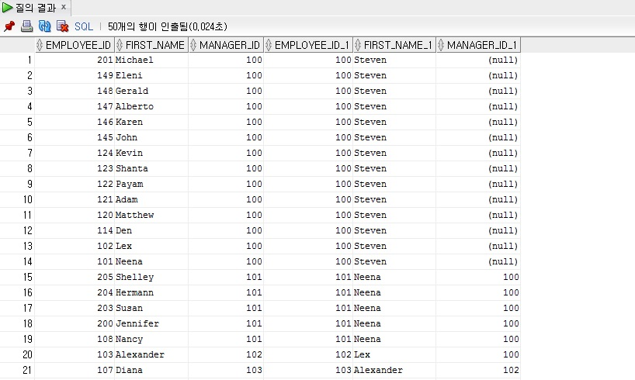
--SELF JOIN
SELECT A.EMPLOYEE_ID, A.FIRST_NAME, A.MANAGER_ID, B.EMPLOYEE_ID, B.FIRST_NAME, B.MANAGER_ID
FROM EMPLOYEES A, EMPLOYEES B
WHERE A.MANAGER_ID = B.EMPLOYEE_ID;
MANAGER를 검색하고 싶은 경우로
MANAGER_ID와 EMPLOYEE_ID가 같은 경우에 해당한다

Slide 22
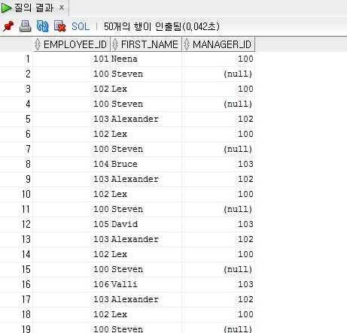
SELECT A.EMPLOYEE_ID, A.FIRST_NAME, A.MANAGER_ID –-계층 형 구조
FROM EMPLOYEES A
START WITH A.MANAGER_ID IS NOT NULL
CONNECT BY PRIOR A.MANAGER_ID = A.EMPLOYEE_ID;
MANAGER를 따라서 계층 형으로
계속해서 검색하고 싶은 경우에
해당한다
(다음 페이지에 계속)

Slide 23
계층 형 쿼리(셀프 조인 고급)
계층형 쿼리
여러 행의 값을 한 행으로 표현
계층형 함수

Slide 24
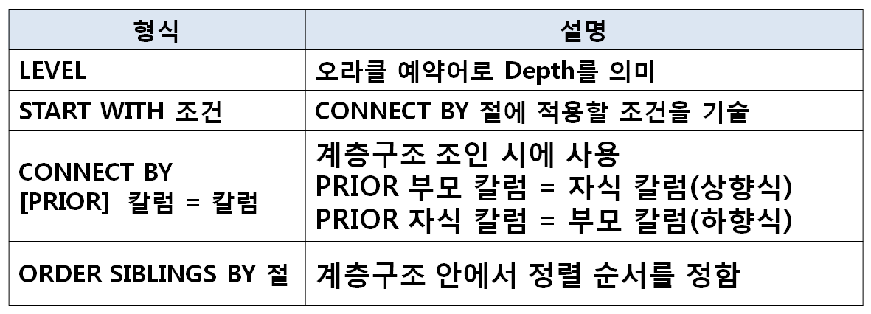
1. 계층형 쿼리 (1/2)
SELECT LEVEL, A.EMPLOYEE_ID, A.FIRST_NAME, A.SALARY,
A.MANAGER_ID, B.FIRST_NAME AS MANAGER_NAME
FROM EMPLOYEES A, EMPLOYEES B
WHERE A.MANAGER_ID = B.EMPLOYEE_ID (+)
CONNECT BY A.MANAGER_ID = A.EMPLOYEE_ID;

Slide 25
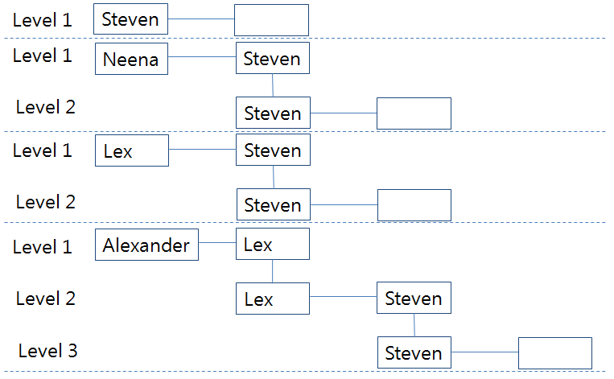
1. 계층형 쿼리 (2/3)
상향식(직원 -> 상위메니저-> 차 상위 메니저...)
SELECT LEVEL, A.EMPLOYEE_ID, A.FIRST_NAME, A.SALARY,
A.MANAGER_ID, B.FIRST_NAME AS MANAGER_NAME
FROM EMPLOYEES A, EMPLOYEES B
WHERE A.MANAGER_ID = B.EMPLOYEE_ID (+)
CONNECT BY PRIOR A.MANAGER_ID = A.EMPLOYEE_ID;

Slide 26
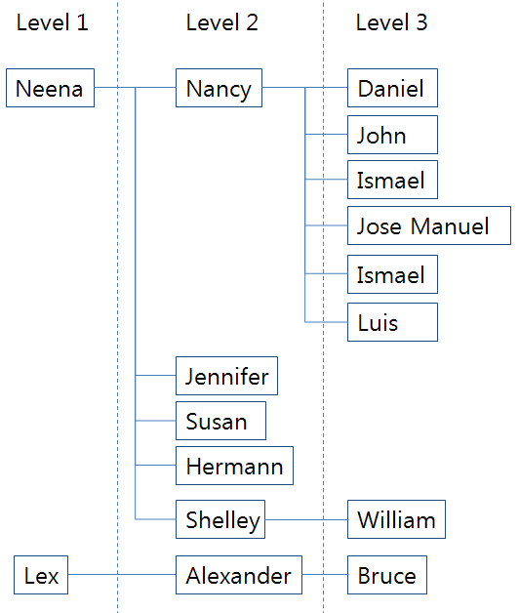
1. 계층형 쿼리 (3/3)
하향식(직원 -> 하위 직원-> 차 하위 직원...)
SELECT LEVEL, A.EMPLOYEE_ID, A.FIRST_NAME, A.SALARY,
A.MANAGER_ID, B.FIRST_NAME AS MANAGER_NAME
FROM EMPLOYEES A, EMPLOYEES B
WHERE A.MANAGER_ID = B.EMPLOYEE_ID (+)
CONNECT BY A.MANAGER_ID = PRIOR A.EMPLOYEE_ID;

Slide 27
2. 여러 행의 값을 한 행으로 표현
숫자형 처리
그룹 함수를 이용한 처리
SELECT FIRST_NAME, LAST_NAME, SUM(SALARY)
FROM EMPLOYEES
GROUP BY FIRST_NAME, LAST_NAME
문자형 처리
상황에 따라 처리 방법이 다양함
- 그룹 함수 (결과 ROW의 수를 명확히 아는경우)
- WMSYS 함수 (WM_CONCAT : 11g 까지 사용)
- 오라클 함수 (LISTAGG–11g 이상, XMLAGG-10g 이상)
- 계층형 함수 (SYS_CONNECT_BY_PATH)

Slide 28
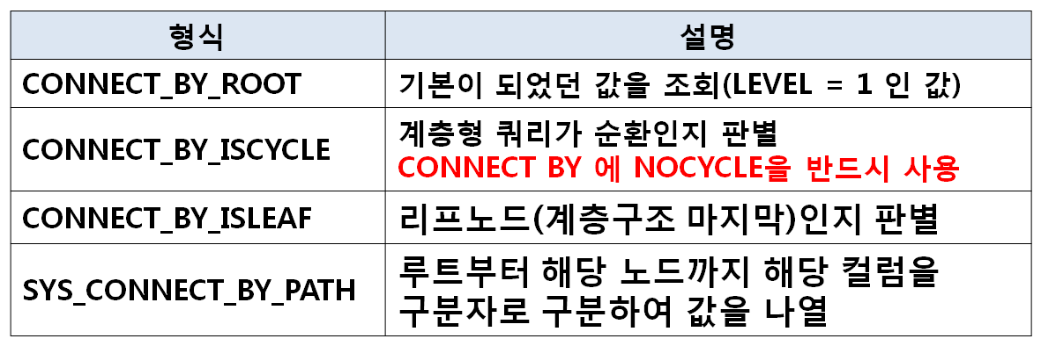
3. 계층형 함수
SELECT LEVEL, EMPLOYEE_ID, MANAGER_ID,
CONNECT_BY_ROOT(EMPLOYEE_ID) AS ROOT_ID,
SUBSTR(SYS_CONNECT_BY_PATH(FIRST_NAME, ', '), 2),
CONNECT_BY_ISCYCLE,
CONNECT_BY_ISLEAF
FROM EMPLOYEES
CONNECT BY NOCYCLE PRIOR MANAGER_ID = EMPLOYEE_ID;

Slide 29
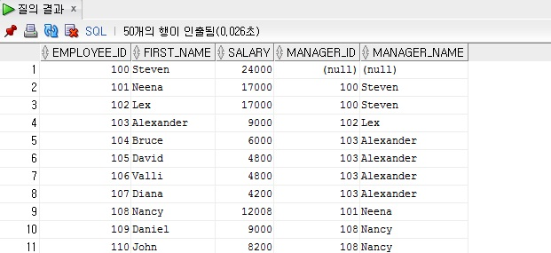
--일반 셀프조인
SELECT A.EMPLOYEE_ID, A.FIRST_NAME, A.SALARY, A.MANAGER_ID, B.FIRST_NAME AS MANAGER_NAME
FROM EMPLOYEES A, EMPLOYEES B
WHERE A.MANAGER_ID = B.EMPLOYEE_ID (+)
ORDER BY EMPLOYEE_ID;
-- 매니저가 누구인지 알아보는 경우.

Slide 30
--계층형 쿼리(정렬)
SELECT LEVEL, A.EMPLOYEE_ID, A.FIRST_NAME, A.SALARY, A.MANAGER_ID, B.FIRST_NAME AS MANAGER_NAME
FROM EMPLOYEES A, EMPLOYEES B
WHERE A.MANAGER_ID = B.EMPLOYEE_ID (+)
CONNECT BY A.MANAGER_ID = A.EMPLOYEE_ID
ORDER BY EMPLOYEE_ID;

Slide 31
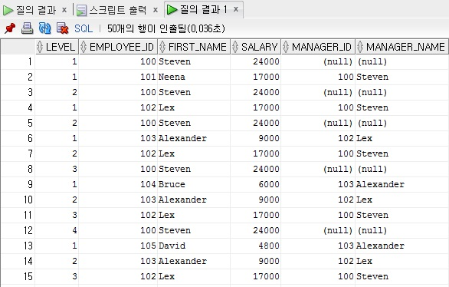
--계층형 쿼리(다단계)
SELECT LEVEL, A.EMPLOYEE_ID, A.FIRST_NAME, A.SALARY,
A.MANAGER_ID, B.FIRST_NAME AS MANAGER_NAME
FROM EMPLOYEES A, EMPLOYEES B
WHERE A.MANAGER_ID = B.EMPLOYEE_ID (+)
CONNECT BY PRIOR A.MANAGER_ID = A.EMPLOYEE_ID; // 상향식

Slide 32
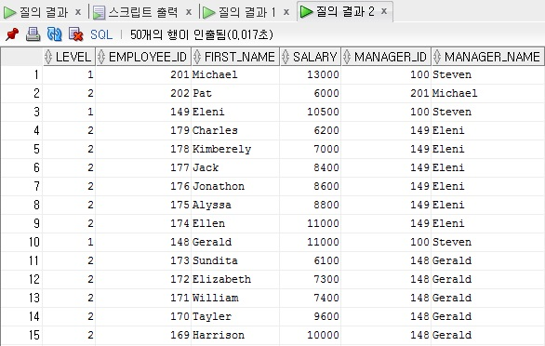
SELECT LEVEL, A.EMPLOYEE_ID, A.FIRST_NAME, A.SALARY,
A.MANAGER_ID, B.FIRST_NAME AS MANAGER_NAME
FROM EMPLOYEES A, EMPLOYEES B
WHERE A.MANAGER_ID = B.EMPLOYEE_ID (+)
CONNECT BY A.MANAGER_ID = PRIOR A.EMPLOYEE_ID; // 하향식
-- 계층 형 쿼리에서는 PRIOR가 중요한 역할을 한다.

Slide 33
--다단계 계층형 -> 단일
SELECT LEVEL, A.EMPLOYEE_ID, A.FIRST_NAME, A.SALARY, A.MANAGER_ID, B.FIRST_NAME AS MANAGER_NAME
FROM EMPLOYEES A, EMPLOYEES B
WHERE A.MANAGER_ID = B.EMPLOYEE_ID (+)
AND LEVEL = 1
CONNECT BY PRIOR A.MANAGER_ID = A.EMPLOYEE_ID;
-- LEVEL이 1인 내용만 보여진다.

Slide 34
--다단계 정렬(ORDER BY) 계층구조가 없어진다
SELECT LEVEL, A.EMPLOYEE_ID, A.FIRST_NAME, A.SALARY, A.MANAGER_ID, B.FIRST_NAME AS MANAGER_NAME
FROM EMPLOYEES A, EMPLOYEES B
WHERE A.MANAGER_ID = B.EMPLOYEE_ID (+)
CONNECT BY PRIOR A.MANAGER_ID = A.EMPLOYEE_ID
ORDER BY FIRST_NAME;
--다단계 정렬(ORDER SIBLINGS BY) 알파벳 순으로 정렬됨과 계층적 나온다
SELECT LEVEL, A.EMPLOYEE_ID, A.FIRST_NAME, A.SALARY,
A.MANAGER_ID, B.FIRST_NAME AS MANAGER_NAME
FROM EMPLOYEES A, EMPLOYEES B
WHERE A.MANAGER_ID = B.EMPLOYEE_ID (+)
CONNECT BY A.MANAGER_ID = PRIOR A.EMPLOYEE_ID
ORDER SIBLINGS BY FIRST_NAME;

Slide 35
--다단계 익히기(상향식)
SELECT LEVEL, A.EMPLOYEE_ID, A.FIRST_NAME, A.SALARY, A.MANAGER_ID, B.FIRST_NAME AS MANAGER_NAME
FROM EMPLOYEES A, EMPLOYEES B
WHERE A.MANAGER_ID = B.EMPLOYEE_ID (+)
CONNECT BY PRIOR A.MANAGER_ID = A.EMPLOYEE_ID;
--다단계 익히기(상향식-조건주기)
SELECT LEVEL, A.EMPLOYEE_ID, A.FIRST_NAME, A.SALARY, A.MANAGER_ID, B.FIRST_NAME AS MANAGER_NAME
FROM EMPLOYEES A, EMPLOYEES B
WHERE A.MANAGER_ID = B.EMPLOYEE_ID (+)
START WITH a.manager_id is not null – 매니저 아이디가 없는 사람은 배제
CONNECT BY PRIOR A.MANAGER_ID = A.EMPLOYEE_ID;

Slide 36
--다단계 익히기(하향식)
SELECT LEVEL, A.EMPLOYEE_ID, A.FIRST_NAME, A.SALARY, A.MANAGER_ID, B.FIRST_NAME AS MANAGER_NAME
FROM EMPLOYEES A, EMPLOYEES B
WHERE A.MANAGER_ID = B.EMPLOYEE_ID (+)
START WITH a.manager_id is not null
CONNECT BY A.MANAGER_ID = PRIOR A.EMPLOYEE_ID;
--다단계 익히기(하향식-정렬)
SELECT LEVEL, A.EMPLOYEE_ID, A.FIRST_NAME, A.SALARY, A.MANAGER_ID, B.FIRST_NAME AS MANAGER_NAME
FROM EMPLOYEES A, EMPLOYEES B
WHERE A.MANAGER_ID = B.EMPLOYEE_ID (+)
START WITH a.manager_id is not null – 매니저 아이디가 없는 사람은 배제
CONNECT BY A.MANAGER_ID = PRIOR A.EMPLOYEE_ID
ORDER SIBLINGS BY A.SALARY DESC; --역순으로

Slide 37
--여러 행의 값을 한 행으로 표현하기
--숫자
SELECT DEPARTMENT_ID, SUM(SALARY)
FROM EMPLOYEES
GROUP BY DEPARTMENT_ID;
--대상쿼리
SELECT DISTINCT FIRST_NAME AS NAME -- DISTINCT 중복제거
FROM EMPLOYEES
WHERE FIRST_NAME IN ('Lex', 'Neena', 'Steven')
ORDER BY NAME;

Slide 38
--DECODE 또는 CASE 를 이용하여 컬럼 분리
--DECODE
SELECT DECODE(NAME, 'Lex', NAME, '') AS NAME1
, DECODE(NAME, 'Neena', NAME, '') AS NAME2
, DECODE(NAME, 'Steven', NAME, '') AS NAME3
FROM
( --서브 쿼리(일종의 테이블)
SELECT DISTINCT FIRST_NAME AS NAME
FROM EMPLOYEES
WHERE FIRST_NAME IN ('Lex', 'Neena', 'Steven')
ORDER BY NAME
);

Slide 39
--CASE문( XXX면 NAME 으로 아니면 ‘’ )
SELECT CASE WHEN NAME = 'Lex' THEN NAME ELSE '' END AS NAME1
, CASE WHEN NAME = 'Neena' THEN NAME ELSE '' END AS NAME2
, CASE WHEN NAME = 'Steven' THEN NAME ELSE '' END AS NAME3
FROM
(
SELECT DISTINCT FIRST_NAME AS NAME
FROM EMPLOYEES
WHERE FIRST_NAME IN ('Lex', 'Neena', 'Steven')
ORDER BY NAME
);

Slide 40
--그룹 함수를 이용하여 여러 개의 행을 하나의 행으로 바꿔준다.
SELECT MAX(NAME1) || ', ' || MAX(NAME2) || ', '|| MAX(NAME3) AS NAME
FROM
(
SELECT CASE WHEN NAME = 'Lex' THEN NAME ELSE '' END AS NAME1
, CASE WHEN NAME = 'Neena' THEN NAME ELSE '' END AS NAME2
, CASE WHEN NAME = 'Steven' THEN NAME ELSE '' END AS NAME3
FROM
(
SELECT DISTINCT FIRST_NAME AS NAME
FROM EMPLOYEES
WHERE FIRST_NAME IN ('Lex', 'Neena', 'Steven')
ORDER BY NAME
)
);

Slide 41
--> 11g 부터 사용하는 LISTAGG 함수 사용(11g 에서는 4000byte 넘을때 문제 발생)
SELECT LISTAGG(NAME, ', ') WITHIN GROUP (ORDER BY NAME) AS NAME
FROM
(
SELECT DISTINCT FIRST_NAME AS NAME
FROM EMPLOYEES
WHERE FIRST_NAME IN ('Lex', 'Neena', 'Steven')
ORDER BY NAME
);

Slide 42
--> XMLAGG 사용 방법(10g부터 사용가능 - 4000byte 이상도 가능하나 성능에서 문제 발생)
SELECT SUBSTR(XMLAGG(XMLELEMENT(IMSI, ', ', NAME)
ORDER BY NAME).Extract('//text()'), 2) AS NAME
FROM
(
SELECT DISTINCT FIRST_NAME AS NAME
FROM EMPLOYEES
WHERE FIRST_NAME IN ('Lex', 'Neena', 'Steven')
ORDER BY NAME
);

Slide 43
--> 계층 함수로 값을 구하기
--계층형 구조 만들기(SYS_CONNECT_BY_PATH 확인)
SELECT SYS_CONNECT_BY_PATH(NAME, ', '), NAME
FROM
(
SELECT ROWNUM AS ROW_ID, ROWNUM - 1 AS P_ROW_ID, NAME
FROM
(
SELECT DISTINCT FIRST_NAME AS NAME
FROM EMPLOYEES
WHERE FIRST_NAME IN ('Lex', 'Neena', 'Steven')
ORDER BY NAME
)
)
CONNECT BY PRIOR ROW_ID = P_ROW_ID;

Slide 44
--계층형 구조 만들기(SYS_CONNECT_BY_PATH 확인-조건 부여)
SELECT SYS_CONNECT_BY_PATH(NAME, ', '), NAME
FROM
(
SELECT ROWNUM AS ROW_ID, ROWNUM - 1 AS P_ROW_ID, NAME
FROM
(
SELECT DISTINCT FIRST_NAME AS NAME
FROM EMPLOYEES
WHERE FIRST_NAME IN ('Lex', 'Neena', 'Steven')
ORDER BY NAME
)
)
START WITH ROW_ID = 1
CONNECT BY PRIOR ROW_ID = P_ROW_ID;

Slide 45
--그룹함수로 한줄로 바꾸기
SELECT MAX(SYS_CONNECT_BY_PATH(NAME, ', ')) AS NAME
FROM
(
SELECT ROWNUM AS ROWCNT, NAME
FROM
(
SELECT DISTINCT FIRST_NAME AS NAME
FROM EMPLOYEES
WHERE FIRST_NAME IN ('Lex', 'Neena', 'Steven')
ORDER BY NAME
)
)
START WITH ROWCNT = 1
CONNECT BY PRIOR ROWCNT = ROWCNT-1;

Slide 46
--원하는 내용으로 만들기 위해 잘라내기
SELECT SUBSTR(MAX(SYS_CONNECT_BY_PATH(NAME, ', ')), 2) AS NAME
FROM
(
SELECT ROWNUM AS ROWCNT, NAME
FROM
(
SELECT DISTINCT FIRST_NAME AS NAME
FROM EMPLOYEES
WHERE FIRST_NAME IN ('Lex', 'Neena', 'Steven')
ORDER BY NAME
)
)
START WITH ROWCNT = 1
CONNECT BY PRIOR ROWCNT = ROWCNT-1;

Slide 47
--묶음 그룹으로 나열하기
--0.LISTAGG
SELECT LISTAGG(FIRST_NAME, ', ') WITHIN GROUP (ORDER BY FIRST_NAME) AS NAME
FROM EMPLOYEES
GROUP BY MANAGER_ID
ORDER BY MANAGER_ID NULLS FIRST;

Slide 48
--1.기본쿼리 구하기
SELECT MANAGER_ID, FIRST_NAME
FROM EMPLOYEES
ORDER BY MANAGER_ID NULLS FIRST;

Slide 49
--2.ROW_NUMBER() 윈도우 함수를 이용하여 ROWCNT 구하여 정렬
SELECT ROW_NUMBER()
OVER(PARTITION BY MANAGER_ID ORDER BY FIRST_NAME)
AS ROWCNT, MANAGER_ID, FIRST_NAME AS NAME
FROM
(
SELECT MANAGER_ID, FIRST_NAME
FROM EMPLOYEES
);

Slide 50
--2.윈도우 함수 없이 ROWCNT 구하여 정렬
SELECT ROWNUM - CNT AS ROWCNT, MANAGER_ID,
FIRST_NAME AS NAME
FROM
(
SELECT MANAGER_ID, FIRST_NAME,
(SELECT COUNT(*) FROM EMPLOYEES B
WHERE NVL(B.MANAGER_ID, 0) < NVL(A.MANAGER_ID, 0))
AS CNT
FROM EMPLOYEES A
ORDER BY MANAGER_ID NULLS FIRST, FIRST_NAME
);

Slide 51
--3.계층형 구하기
SELECT LEVEL, ROWCNT, MANAGER_ID, NAME, SYS_CONNECT_BY_PATH(NAME, ',')
FROM
(
SELECT ROWNUM - CNT AS ROWCNT, MANAGER_ID, FIRST_NAME AS NAME
FROM
(
SELECT MANAGER_ID, FIRST_NAME,
(SELECT COUNT(*) FROM EMPLOYEES B
WHERE NVL(B.MANAGER_ID, 0) < NVL(A.MANAGER_ID, 0)) AS CNT
FROM EMPLOYEES A
ORDER BY MANAGER_ID NULLS FIRST, FIRST_NAME
)
)
START WITH ROWCNT = 1
CONNECT BY PRIOR ROWCNT = ROWCNT -1 AND PRIOR MANAGER_ID = MANAGER_ID;
이전 부분

Slide 52
--4.원하는 내용으로 추출(그룹 함수로 가장 큰 값 구하기)
SELECT MANAGER_ID, MAX(SYS_CONNECT_BY_PATH(NAME, ','))
FROM
(
SELECT ROWNUM - CNT AS ROWCNT, MANAGER_ID, FIRST_NAME AS NAME
FROM
(
SELECT MANAGER_ID, FIRST_NAME,
(SELECT COUNT(*) FROM EMPLOYEES B
WHERE NVL(B.MANAGER_ID, 0) < NVL(A.MANAGER_ID, 0)) AS CNT
FROM EMPLOYEES A
ORDER BY MANAGER_ID NULLS FIRST, FIRST_NAME
)
)
START WITH ROWCNT = 1
CONNECT BY PRIOR ROWCNT = ROWCNT -1 AND PRIOR MANAGER_ID = MANAGER_ID
GROUP BY MANAGER_ID;

Slide 53
--5.원하는 내용으로 추출(SUBSTR로 추출)
SELECT MANAGER_ID, SUBSTR(MAX(SYS_CONNECT_BY_PATH(NAME, ',')), 2) AS NAME
FROM
(
SELECT ROWNUM - CNT AS ROWCNT, MANAGER_ID, FIRST_NAME AS NAME
FROM
(
SELECT MANAGER_ID, FIRST_NAME,
(SELECT COUNT(*) FROM EMPLOYEES B
WHERE NVL(B.MANAGER_ID, 0) < NVL(A.MANAGER_ID, 0)) AS CNT
FROM EMPLOYEES A
ORDER BY MANAGER_ID NULLS FIRST, FIRST_NAME
)
)
START WITH ROWCNT = 1
CONNECT BY PRIOR ROWCNT = ROWCNT -1 AND PRIOR MANAGER_ID = MANAGER_ID
GROUP BY MANAGER_ID
ORDER BY MANAGER_ID NULLS FIRST;

Slide 54
--계층함수를 이용한 방법
--1.계층 형 결합
SELECT LEVEL, EMPLOYEE_ID, MANAGER_ID, SYS_CONNECT_BY_PATH(FIRST_NAME, ', ')
FROM EMPLOYEES
CONNECT BY PRIOR MANAGER_ID = EMPLOYEE_ID;

Slide 55
--2.원하는 내용으로 변경
SELECT LEVEL, EMPLOYEE_ID, MANAGER_ID, SUBSTR(SYS_CONNECT_BY_PATH(FIRST_NAME, ', '), 2) AS NAME
FROM EMPLOYEES
CONNECT BY PRIOR MANAGER_ID = EMPLOYEE_ID;

Slide 56
--3.조건 넣기
SELECT EMPLOYEE_ID, MANAGER_ID, NAME
FROM
(
SELECT LEVEL, EMPLOYEE_ID, MANAGER_ID, SUBSTR(SYS_CONNECT_BY_PATH(FIRST_NAME, ', '), 2) AS NAME
FROM EMPLOYEES
CONNECT BY PRIOR MANAGER_ID = EMPLOYEE_ID
)
WHERE MANAGER_ID IS NULL;

Slide 57
--4.계층형 함수로 내용 변경
SELECT EMPLOYEE_ID, MANAGER_ID, NAME
FROM
(
SELECT LEVEL, CONNECT_BY_ROOT(EMPLOYEE_ID) AS EMPLOYEE_ID, MANAGER_ID, SUBSTR(SYS_CONNECT_BY_PATH(FIRST_NAME, ', '), 2) AS NAME
FROM EMPLOYEES
CONNECT BY PRIOR MANAGER_ID = EMPLOYEE_ID
)
WHERE MANAGER_ID IS NULL;

Slide 58
--계층형 함수
SELECT LEVEL, EMPLOYEE_ID, MANAGER_ID,
CONNECT_BY_ROOT(EMPLOYEE_ID) AS ROOT_ID,
SUBSTR(SYS_CONNECT_BY_PATH(FIRST_NAME, ', '), 2) AS NAME,
CONNECT_BY_ISCYCLE, CONNECT_BY_ISLEAF
FROM EMPLOYEES
CONNECT BY NOCYCLE PRIOR MANAGER_ID = EMPLOYEE_ID;

Slide 59
--조건 식 가능(WHERE 로 계층 형 함수 조건 가능)
SELECT LEVEL, EMPLOYEE_ID, MANAGER_ID,
CONNECT_BY_ROOT(EMPLOYEE_ID) AS ROOT_ID,
SUBSTR(SYS_CONNECT_BY_PATH(FIRST_NAME, ', '), 2) AS NAME,
CONNECT_BY_ISCYCLE, CONNECT_BY_ISLEAF
FROM EMPLOYEES
WHERE CONNECT_BY_ISLEAF = 1
CONNECT BY NOCYCLE PRIOR MANAGER_ID = EMPLOYEE_ID;

Slide 60
문제1) Steven King의 부서명을 출력하라.
SELECT B.DEPARTMENT_NAME
FROM EMPLOYEES A, DEPARTMENTS B
WHERE A.DEPARTMENT_ID = B.DEPARTMENT_ID AND
LAST_NAME = 'Hunold' AND FIRST_NAME = 'Alexander';

Slide 61
문제2) IT부서에서 근무하고 있는 사람들을 출력하라.
SELECT A.DEPARTMENT_NAME, B.FIRST_NAME, B.LAST_NAME
FROM DEPARTMENTS A, EMPLOYEES B
WHERE A.DEPARTMENT_ID = B.DEPARTMENT_ID
AND A.DEPARTMENT_NAME = 'Sales';

Slide 62
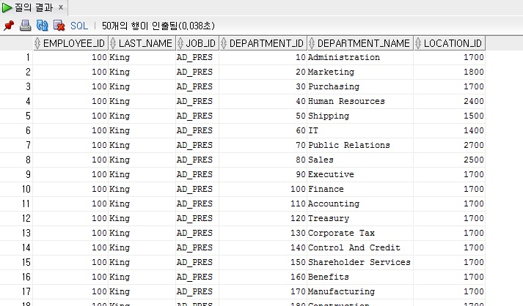
문제3) EMPLOYEES 테이블과 DEPARTMENTS 테이블을 Cartesian Product(모든 가능한 행들의 Join)하여 사원번호,이름,업무,부서번호,부서명,근무지를 출력하여라.
SELECT EMPLOYEE_ID, LAST_NAME, JOB_ID, DEPARTMENTS.DEPARTMENT_ID, DEPARTMENT_NAME, LOCATION_ID
FROM DEPARTMENTS, EMPLOYEES
ORDER BY EMPLOYEE_ID;

Slide 63
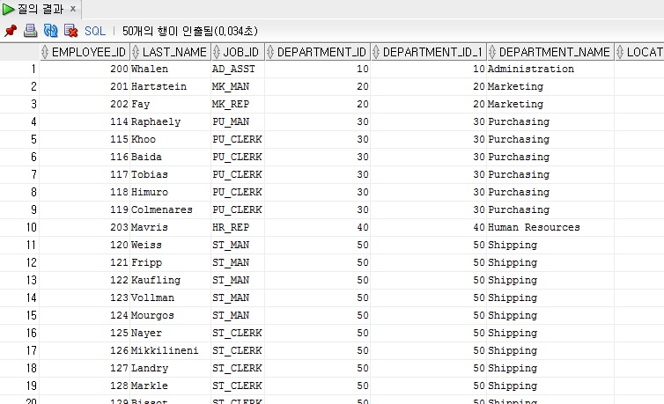
문제4) EMPLOYEES 테이블에서 사원번호,이름,업무, EMPLOYEES 테이블의 부서번호, DEPARTMENTS 테이블의 부서번호,부서명,근무지를 출력하여라.
SELECT EMPLOYEE_ID,LAST_NAME,JOB_ID,EMPLOYEES.
DEPARTMENT_ID,DEPARTMENTS.DEPARTMENT_ID,
DEPARTMENT_NAME,LOCATION_ID
FROM DEPARTMENTS,EMPLOYEES
WHERE DEPARTMENTS.DEPARTMENT_ID = EMPLOYEES.DEPARTMENT_ID
ORDER BY DEPARTMENTS.DEPARTMENT_ID;

Slide 64
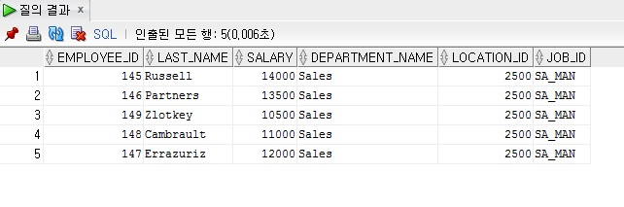
문제5) EMPLOYEES 테이블과 DEPARTMENTS 테이블의 부서번호를 조인하고
SA_MAN 사원만의 사원번호,이름,급여,부서명,근무지를 출력하라.
(Alias를 사용)
SELECT e.EMPLOYEE_ID,e.LAST_NAME,e.SALARY,d.DEPARTMENT_NAME,
d.LOCATION_ID, e.JOB_ID
FROM DEPARTMENTS d, EMPLOYEES e
WHERE d.DEPARTMENT_ID = e.DEPARTMENT_ID
AND e.JOB_ID = 'SA_MAN';

Slide 65
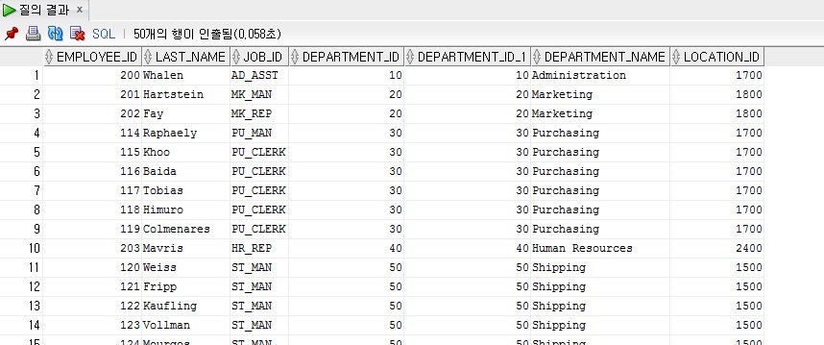
문제6) EMPLOYEES 테이블과 DEPARTMENTS 테이블에서 DEPARTMENTS 테이블에 있는 모든 자료를 사원번호,이름,업무, EMPLOYEES 테이블의 부서번호, DEPARTMENTS 테이블의 부서번호,부서명,근무지를 출력하여라
(Outer Join)
SELECT e.EMPLOYEE_ID,e.LAST_NAME,e.JOB_ID,e.DEPARTMENT_ID,
d.DEPARTMENT_ID,d.DEPARTMENT_NAME,d.LOCATION_ID
FROM DEPARTMENTS d,EMPLOYEES e
WHERE d.DEPARTMENT_ID = e.DEPARTMENT_ID(+);

Slide 66
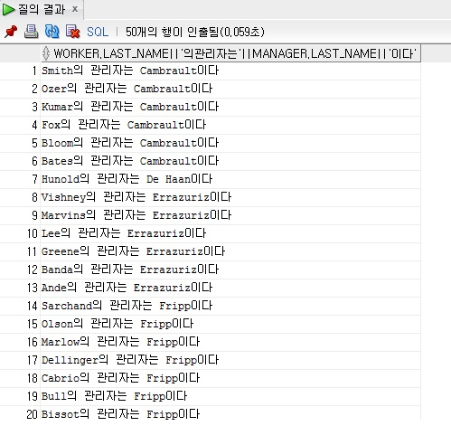
문제7) EMPLOYEES 테이블에서 Self join하여 관리자(매니저)를 출력하여라.
SELECT worker.LAST_NAME || '의 관리자는 ' || manager.LAST_NAME || '이다'
FROM EMPLOYEES worker, EMPLOYEES manager
WHERE worker.MANAGER_ID = manager.EMPLOYEE_ID;

Slide 67
문제8) EMPLOYEES 테이블에서 left join하여 관리자(매니저)를 출력하고
매니저 아이디가 없는 사람은 배제하고 하향식으로 하며, 급여는 역순으로
출력하라.
SELECT A.EMPLOYEE_ID, A.FIRST_NAME, A.SALARY, A.MANAGER_ID, B.FIRST_NAME AS MANAGER_NAME
FROM EMPLOYEES A, EMPLOYEES B
WHERE A.MANAGER_ID = B.EMPLOYEE_ID (+)
START WITH a.manager_id is not null
-- AND a.manager_id is not null
CONNECT BY A.MANAGER_ID = PRIOR A.EMPLOYEE_ID
ORDER BY A.SALARY DESC;

Slide 68
문제9) EMPLOYEES 테이블에서 right join하여 관리자(매니저)가 108번
상향식으로 급여는 역순으로 출력하라.
SELECT A.EMPLOYEE_ID, A.FIRST_NAME, A.SALARY, A.MANAGER_ID, B.FIRST_NAME AS MANAGER_NAME
FROM EMPLOYEES A, EMPLOYEES B
WHERE A.MANAGER_ID(+) = B.EMPLOYEE_ID AND A.MANAGER_ID = '108'
CONNECT BY PRIOR A.MANAGER_ID = A.EMPLOYEE_ID
ORDER BY A.SALARY DESC;

